Slide 1
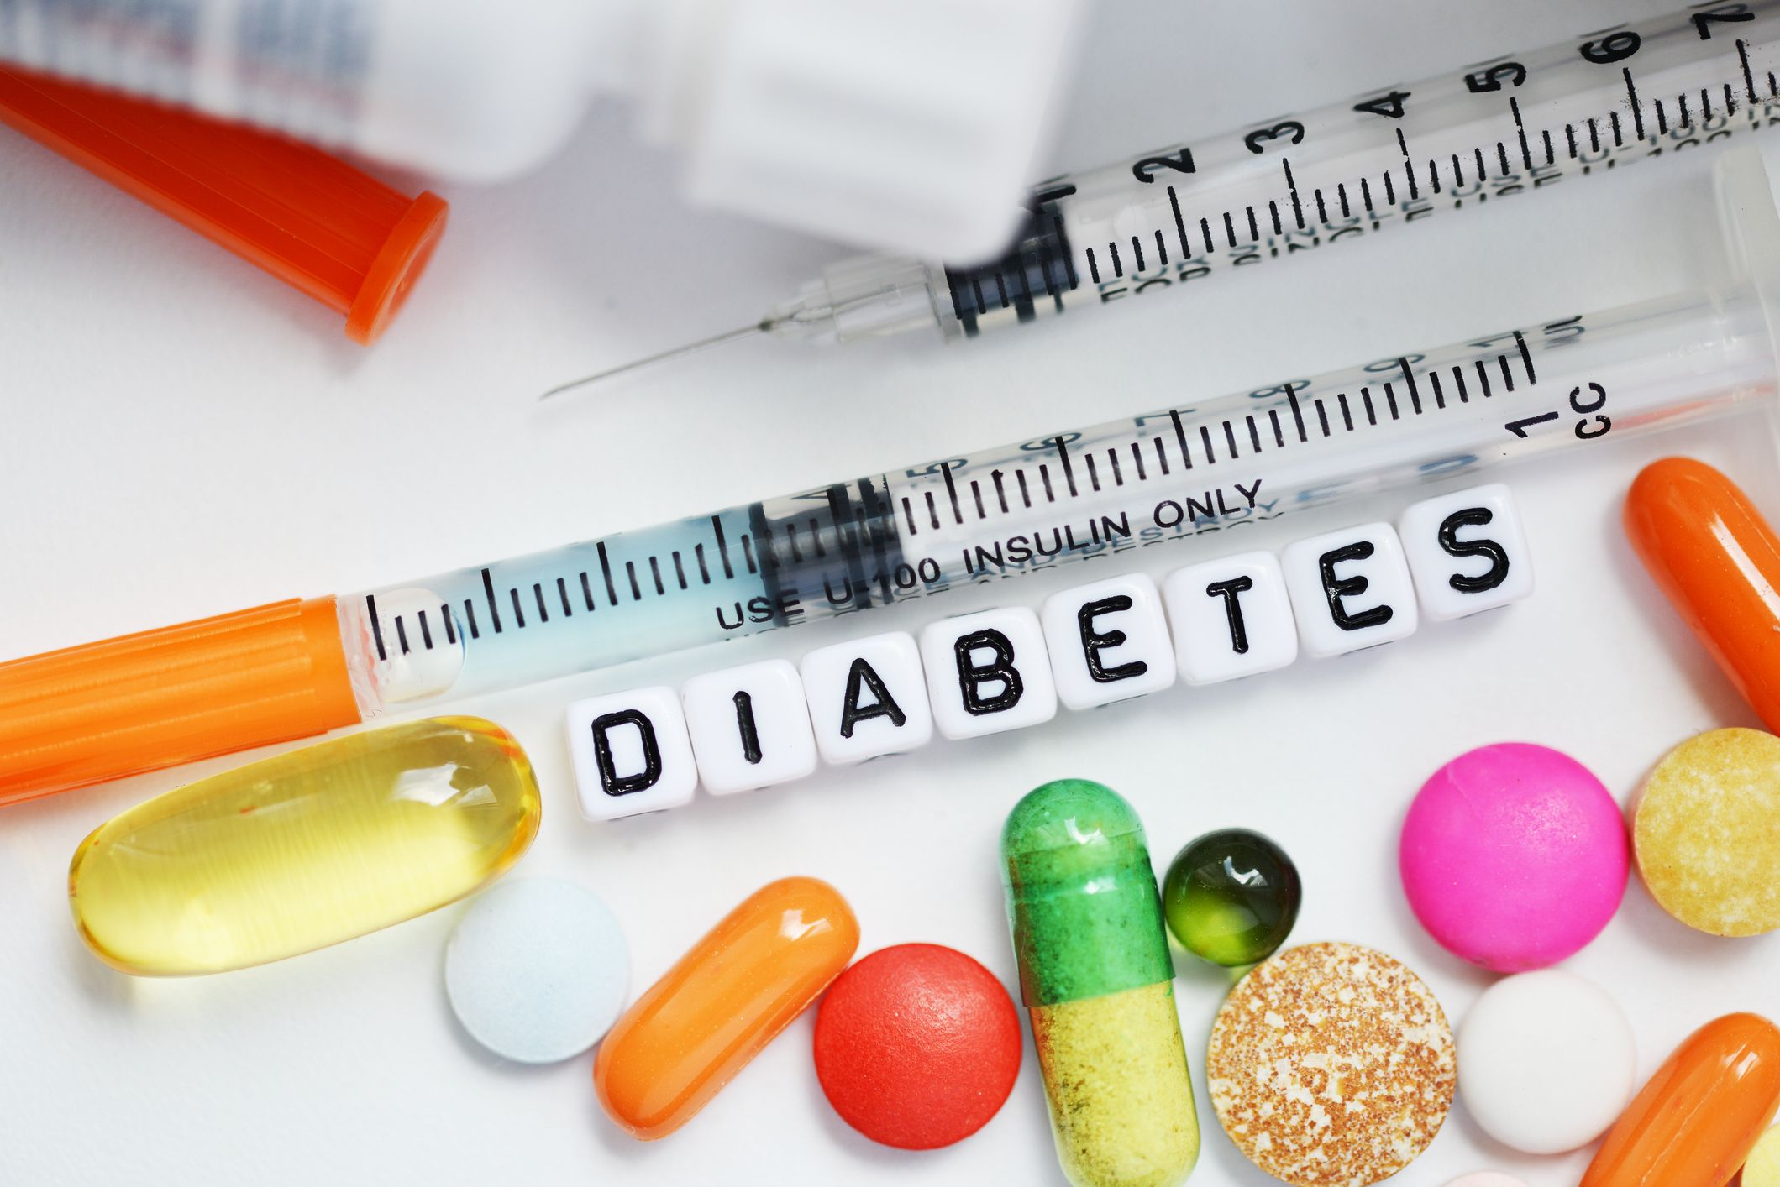
Diabetes prediction
Felix Doctorman & Alin Finkelshtein

Slide 2

Diabetes problem with the body’s production of or use of the hormone insulin
Diabetes type 1
The pancreas does not make insulin, because the body's immune system attacks the islet cells in the pancreas that make insulin.
Comes on fast
Requires insulin to manage
Requires insulin to manage
Relatively uncommon (1.9 million people in the U.S.)
Diabetes type 2
The pancreas makes less insulin than used to, and your body becomes resistant to insulin.
Takes time to develop
Diet, exercise, oral or injectable medications. In some cases insulin may become necessary.
Often diagnosed mid-life
Increasingly common (35.4 million people in the U.S.)

Slide 3
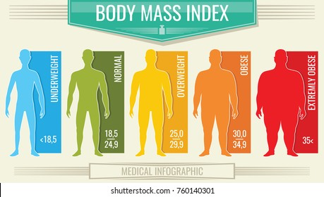
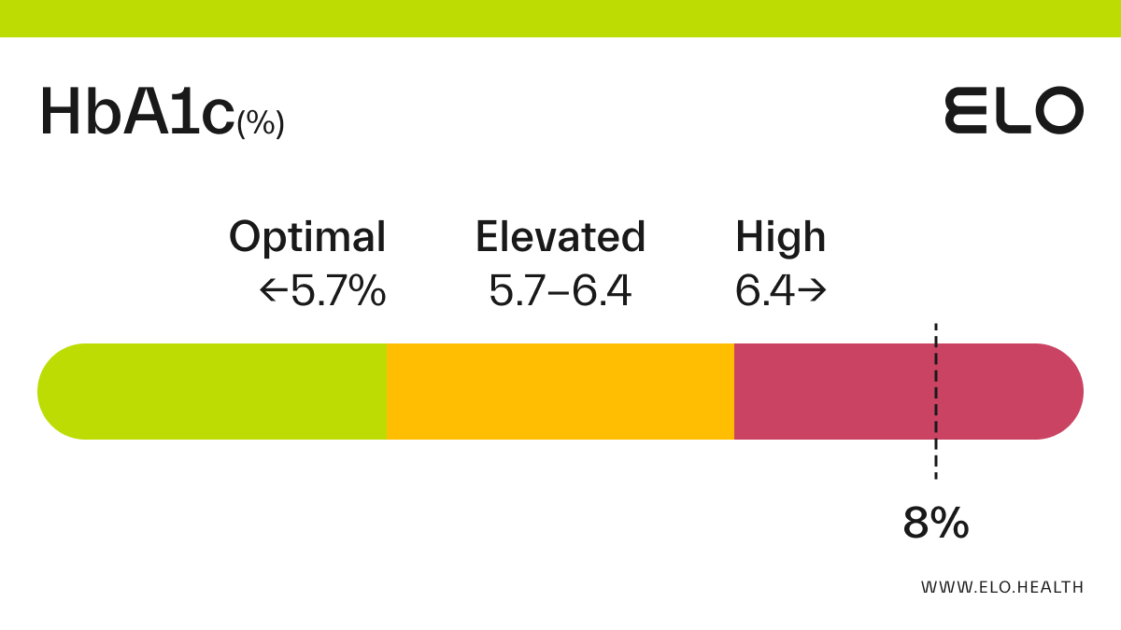
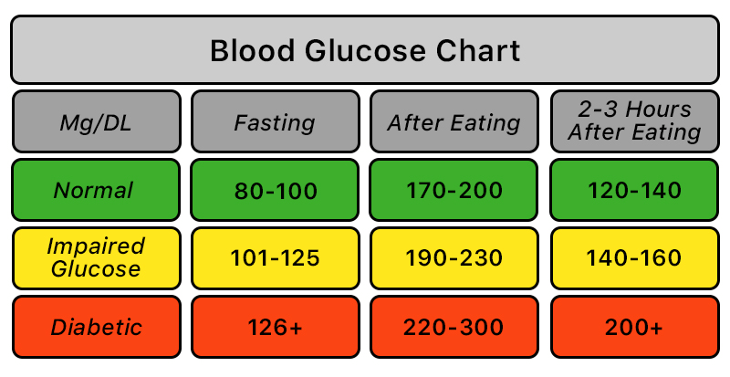
Features
Age
BMI
Gender
Body mass index (BMI)
Hypertension - Hypertension is a medical condition in which the blood pressure in the arteries is persistently elevated. It has values a 0 or 1 where 0 indicates they don’t have hypertension and for 1 it means they have hypertension.
Heart disease - Heart disease is another medical condition that is associated with an increased risk of developing diabetes. It has values a 0 or 1 where 0 indicates they don’t have heart disease and for 1 it means they have heart disease.
Smoking history - :5 categories : not current, former, No Info, current, never and ever.
HbA1c level - glycated haemoglobin level is a measure of a person's average blood sugar level over the past 2-3 months. Higher levels indicate a greater risk of developing diabetes. Mostly more than 6.5% of HbA1c Level indicates diabetes.
Blood glucose level - Blood glucose level refers to the amount of glucose in the bloodstream at a given time. High blood glucose levels are a key indicator of diabetes.

Slide 4
The data
index | gender | age | hypertension | heart_ disease | Smoking _history | bmi | HbA1c_level | blood_ glucose_level | diabetes
0 | Female | 80.0 | 0 | 1 | never | 25.19 | 6.6 | 140 | 0
1 | Female | 54.0 | 0 | 0 | No Info | 27.32 | 6.6 | 80 | 0
2 | Male | 28.0 | 0 | 0 | never | 27.32 | 5.7 | 158 | 0
3 | Female | 36.0 | 0 | 0 | current | 23.45 | 5.0 | 155 | 0
4 | Male | 76.0 | 1 | 1 | current | 20.14 | 4.8 | 155 | 0

Slide 5
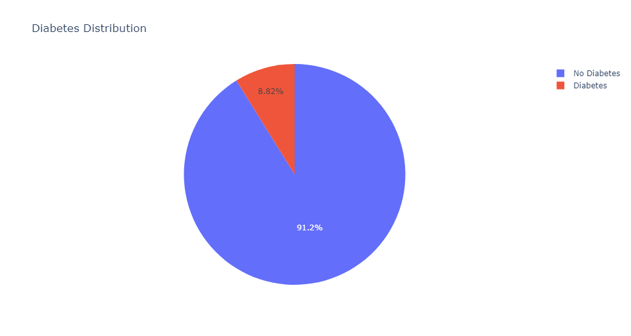
8.82% have diabetes
87646 1 8482
The dataset is imbalanced
The target variable 'diabetes' in this dataset is imbalanced, with a majority of 87,646 individuals labeled as 'No Diabetes' and only 8,482 labeled as 'Diabetes’.

Slide 6
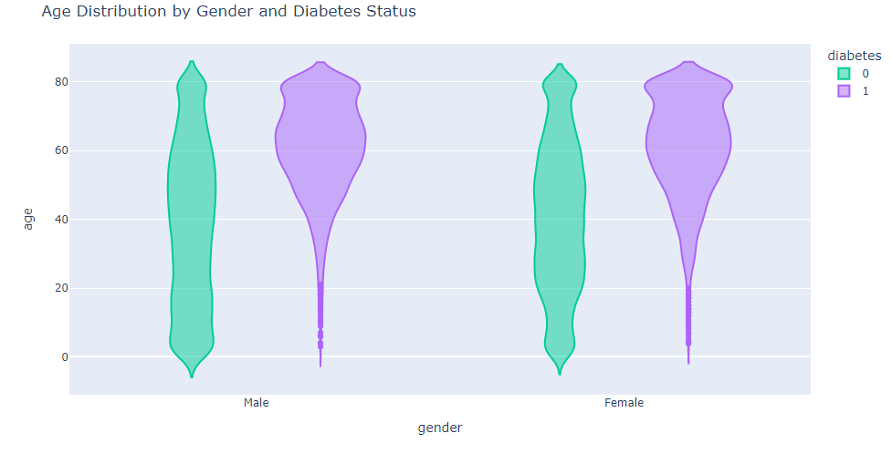
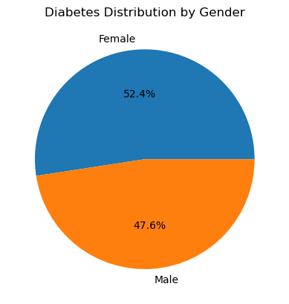
Female tend to have more diabetes then male.
Both sexes tend to get sick at older ages >50

Slide 7
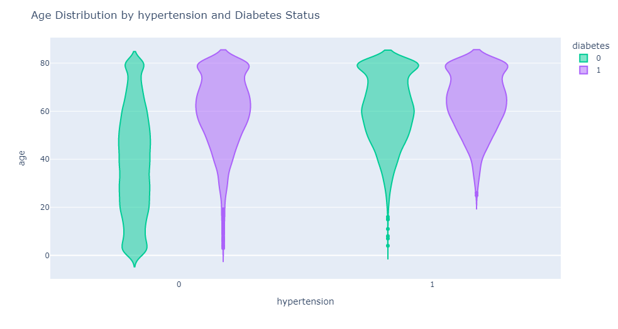
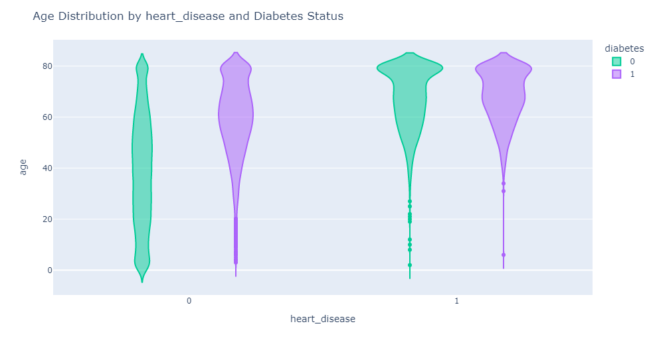
People tend to suffer from hypertension (HT) and heart diseases also at older ages. There are more people that have both diabetes and HT that only diabetes. There are more people that have both diabetes and heart diseases that only diabetes.

Slide 8
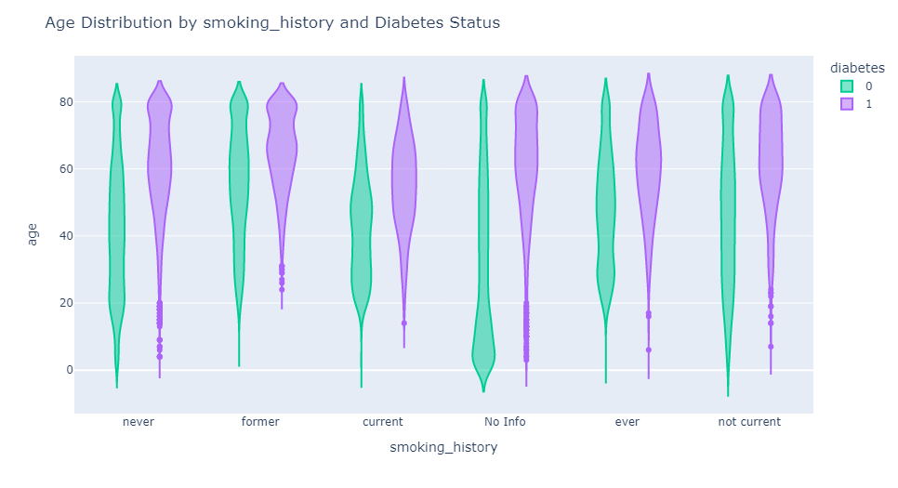
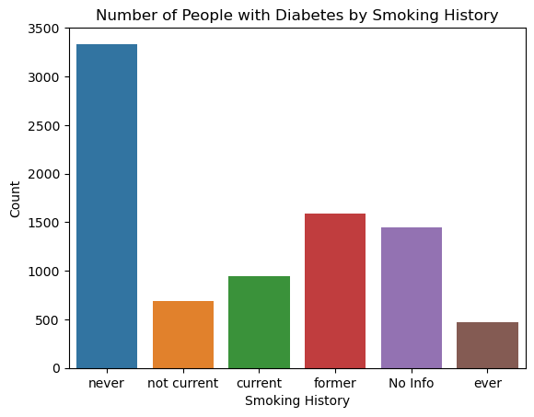
Smoking status & diabetes

Slide 9
